Slide 1
FGM-IS
Female Genital Mutilation - Information Sharing
Presented by: David Lawson
Notes:
Standard title slide

Slide 2
What is FGM-IS?
Currently:
The FGM-IS is a national IT system that supports the early intervention and ongoing safeguarding of girls, under the age of 18, who have a family history of Female Genital Mutilation (FGM).
FGM-IS contains:
an indicator that a girl has a family history of FGM
the date that the FGM indicator was added on to the system
FGM indicator is accessed via:
Summary Care Record Application (SCRa)
or with a local clinical system integrated with FGM-IS. A FHIR Messaging DSTU2 API (https://data.developer.nhs.uk/fhir/fgm/Chapter.6.FHIR%20Messages/index.html). Query/Response only.
The FGM-IS indicator is added / deleted via the SCRa. The FGM-IS indicator is stored on the Spine.
Notes:
Plain slide with subhead and bullets

Slide 3
What is FGM-IS?
Next:
A FHIR R4 API that allows:
Get risk indicator
Add risk indicator
‘Delete’ risk indicator (with a reason)
Update risk indicator (likely not be needed, depends on solution)
The API should query/update the same FGM data store on the Spine that the current DSTU2 FHIR API and SCRa are utilising.
Notes:
Plain slide with subhead and bullets

Slide 4
Option walkthrough
Discovery document
Flag
Flag Service
FamilyMemberHistory

Slide 5
Questions for DA
Discovery document
Referencing national master data stores
Pattern for removing a resource with a reason
Providing a facade on top of a legacy database

Slide 6

Referencing national master data stores
Do we have a consistent approach and best practice? E.g. below demographics, but same point for ODS, SDS.
Include reference, identifier and display. Verbose information in payload, for more follow reference to national data store.
Include reference only. Follow reference to national data store.
Identifier only. Consumer works out reference themselves.
"subject": {
"reference": "https://api.service.nhs.uk/personal-demographics/FHIR/R4/Patient/9000000009",
"display" : "Miss Davina Patient",
"identifier": {
"system": "https://fhir.nhs.uk/Id/nhs-number",
"value": "9000000009"
}
}
"subject": {
"reference": "https://api.service.nhs.uk/personal-demographics/FHIR/R4/Patient/9000000009"
}
"subject": {
"identifier": {
"system": "https://fhir.nhs.uk/Id/nhs-number",
"value": "9000000009"
}
}
Notes:
Sample 3 column icon slide
Alt text is included in these images

Slide 7
Pattern for removing a resource with a reason
How to delete a resource with a custom reason valueset e.g. FGM delete reason codes
Create a common extension and include in an update. PUT /<Resource>
Precedence with RA removal reason. Extension-RARecord-RemovalReason-1. This includes a reason code + supporting comment.
Alternatively could AuditEvent be a common resource to use in an extension?
Use a Header parameter for delete reason. DELETE /<Resource id>
Probably a bit of an anti pattern. For FGM a delete reason can’t currently be retrieved back from an API – does that mean it is metadata? For a general pattern though the removal reason would likely be classified as ‘data’ and should be in payload.
Bundle together <Resource> and an AuditEvent (representing reason) into a FHIR Transaction.
A common use for FHIR transactions is to store a collection of related resources to a server.
Notes:
Plain slide with subhead and bullets

Slide 8
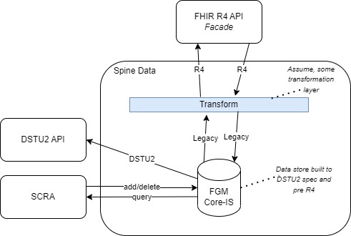
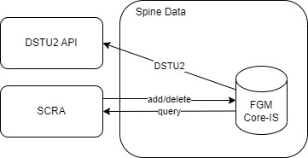
Providing a facade on top of a legacy database
Considerations / best practice for providing a façade on top of a data store built against an older version of FHIR but facaded to a newer version.
For FGM the existing FHIR API is DSTU2, but the new FHIR API will be R4. Not sure how SCRA writes to existing data store.
Question: can we assume that APIM will transform between R4 and an existing database inbound and outbound?
Future
>>>>>>>>>>>
Current
Notes:
Plain slide with subhead and bullets

Slide 9
Providing a facade on top of a legacy database
E.g. Structural differences between resources
DSTU2 Spine-RIS-Flag-1-0 profile does not use category. In the Discovery document we propose supporting Flag.category i.e.
"category": [
{
"coding": [
{
"system": "http://terminology.hl7.org/CodeSystem/flag-category",
"code": "safety",
"display": "Safety"
}
],
"text": "Safety"
}
],
Q. In this instance should we:
Ignore Flag.category (it’s 0..1). This then aligns as close as possible to the existing structure of the DSTU2 Flag profile?
Allow Flag.category if it is deemed useful extra categorisation. Accept that this may be a static value in transformation layer rather than persisted onto existing database.
Notes:
Plain slide with subhead and bullets

Slide 10
Providing a facade on top of a legacy database
Coding differences between resources e.g…..
DSTU2 Spine-RIS-Flag-1-0 profile uses a valueset for Flag.code.coding. In the Discovery document we propose snomed instead
Q. In this instance should we:
Align with the existing valueset? Create our own codesystem for that one value – ‘FGM’?
Use a snomed code instead as it is current best practice? Accept that this may be a value in transformation layer mapped to legacy value in database? Note: unsure if this is the most suitable snomed code.
Existing DSTU2
Discovery document
<code>
<coding>
<system value="http://fhir.nhs.net/ValueSet/risk-indicator-type-1-0"/>
<code value="FGM"/>
</coding>
</code>
"code": {
"coding": [
{
"system": "http://snomed.info/sct",
"code": "902961000000107",
"display": "Family history of FGM (female genital mutilation)"
}
],
"text": "Family history of FGM (female genital mutilation)"
},
Notes:
Sample 2 column icon slide, with placeholder for introtext
Alt text is included in these images

Slide 11
Notes:
Connect with us

